Slide 1
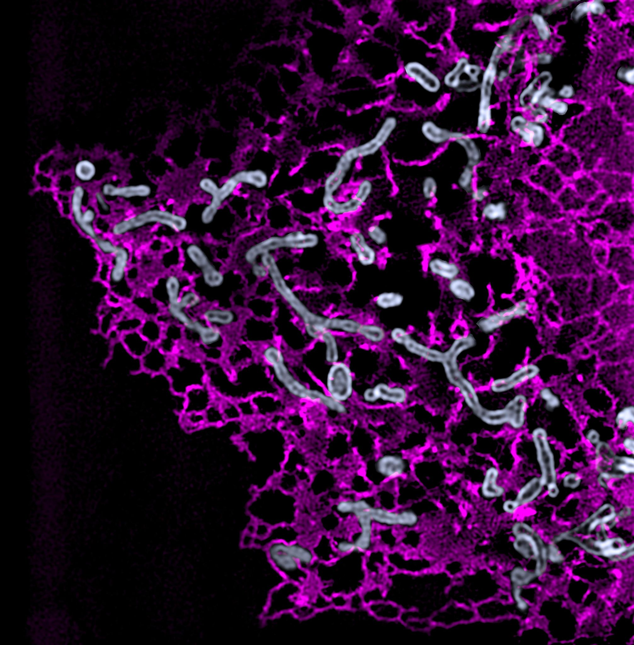


MitoSplit-Net:
detection of
mitochondrial divisions
with neural networks
Santiago Rodriguez
Notes:
Thanks
Hello everyone. Thank you all for your engaging presentations and the EPFL for giving me the unique opportunity to work together with amazing scientists in the Laboratory of Experimental Biophysics.
Introduction
My name is Santiago Rodriguez, I am from Argentina. Currently, I am in my last year of a Master’s degree in Physics in the University of Buenos Aires. student and I am working in on MitoSplit-Net, a neural network that detects mitochondrial divisions.

Slide 2
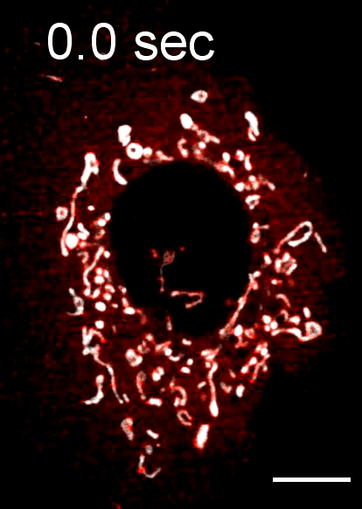
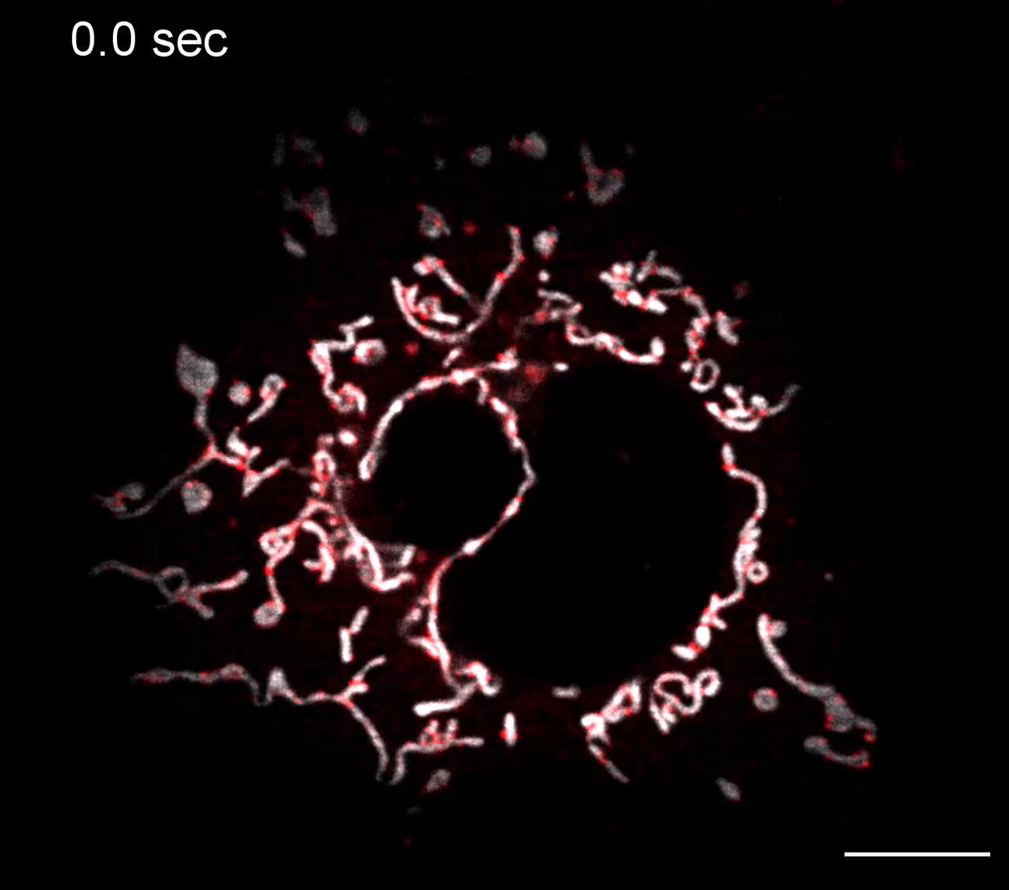
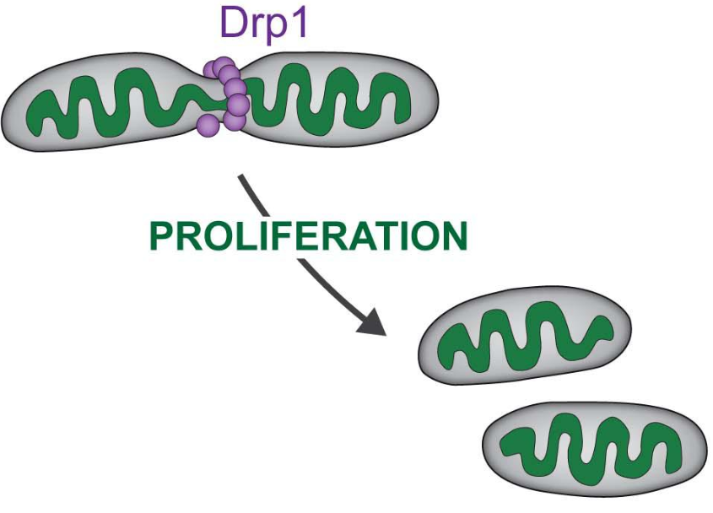
Capturing mitochondrial division requires fast, long term imaging
Fast | Short
Slow | Long
Notes:
Background
One of the main projects of the LEB is concerned with studying mitocondria, organelles that divide and fuse dinamically. These are essential for living organisms, as they regulate metabolism, proliferation and apoptosis. In particular, it is known that the enzyme Drp1 is responsible for midzone constrictions, as you can see in the schematic. This was experimentally demonstrated in a recent work of the group, and here you can see two different time-lapse videos.
Challenges
In the first one, the frame rate is fast and, therefore, membrane dynamics can appreciated. However, this quickly lead to high levels of photobleaching and phototoxicity, so the imaging is short. On the other hand, if the acquisition is slow, sample health is preserved, but the temporal resolution is poor. An optimal solution is adapting the imaging speed in response to events of interest.

Slide 3
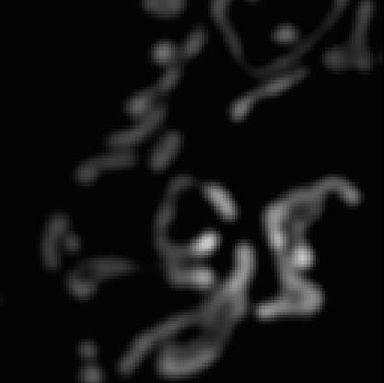
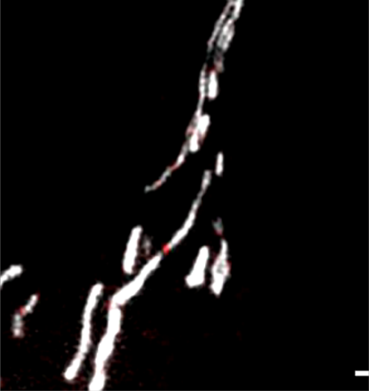
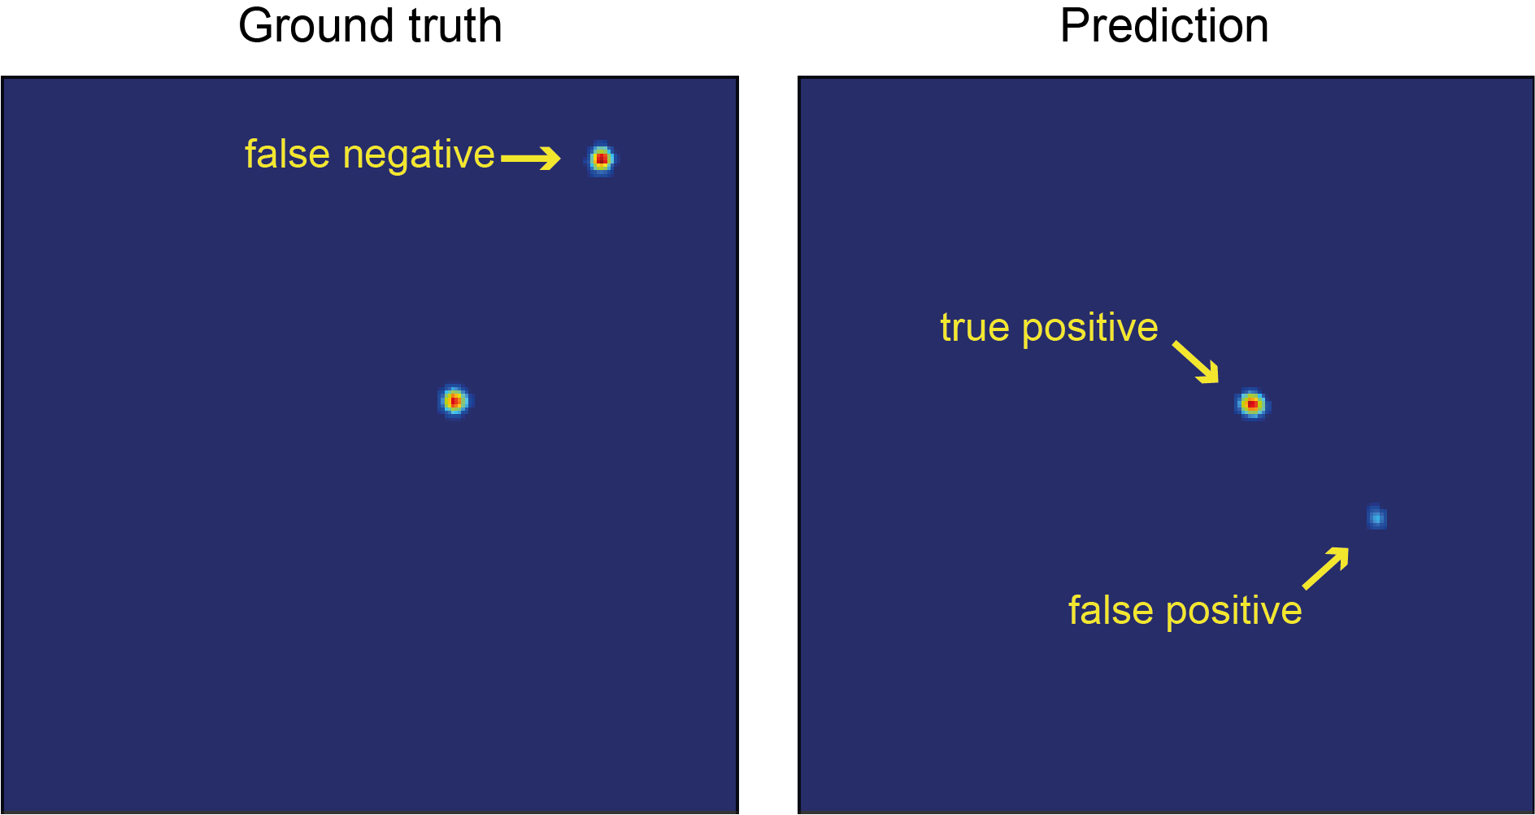
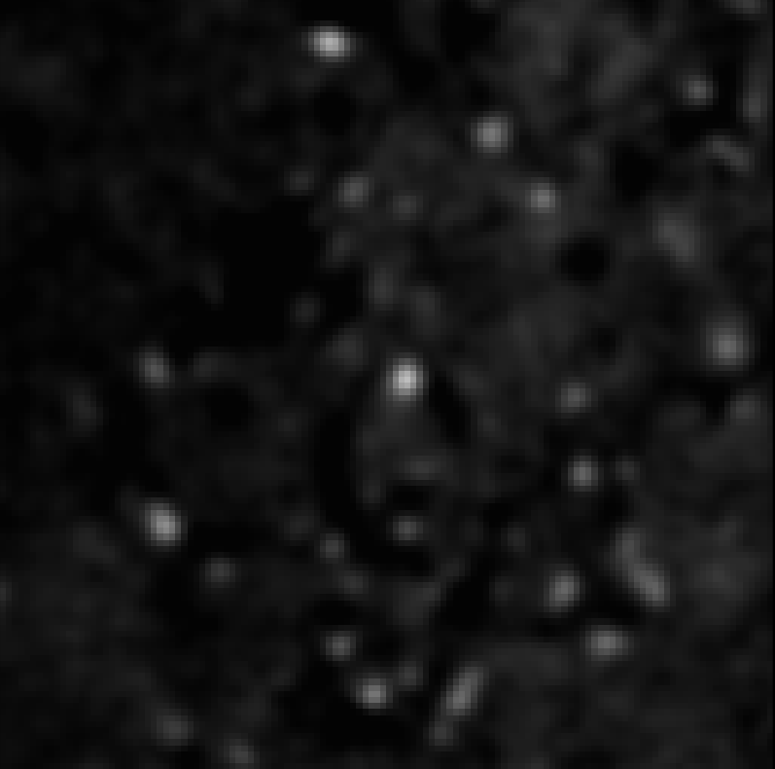
Detection of fission sites
currently depends on Drp1 channel
Mito
Encoder
Decoder
Ground truth
Drp1
TP
Output
37000 images
per channel!
FP
U-Net
Prepared by Dora Mahecic
Notes:
Previous works
To address this challenge, members of the LEB used a U-Net neural network to detect mitochondrial constrictions. This network has two main parts, which are the encoder, that reduces the original image to a set of features related to the probability of division, and the decoder, that reconstructs the probability map of divisions out of the feature vector.
However…
To train the network, former PhD student Dora Mahecic created a ground truth for the probability map, based on a Hessian filter applied to a mitochondria channel plus a Drp1 channel and some manual annotation. However, this model is computationally expensive and experimentally impractical, since it depends on mitochondria and Drp1 channels to make a prediction.

Slide 4
MitoSplit-Net: detection of mitocondrial divisions with neural networks
Input
Mito
Output
Probability
map
Data preprocessing and augmentation
Data preprocessing and augmentation
Training the network
Performance analysis
Adjusting network parameters (number of filters, layers)
Writing a Python module
Proof of concept: Adaptive Temporal Sampling
Notes:
MitoSplit-Net
To solve this problem, I will develop MitoSplit-Net, a neural network with U-net architecture that is able to detect mitochondrial divisions using only mitochondria information. In the following two months, I will
Preprocess and augment the data
Train the network and analyze its performance
Tweak the number of filters and layers
Reusability is also very important
Write a Python module
Proof of concept: ATS optimization

Slide 5
Advances: ground truth preprocessing
Segmentation
of fission sites
(Watershed)
Ground Truth
Distance Transform
Gaussian dilation
Data preprocessing and augmentation
Training the network
Performance analysis
Adjusting network parameters (number of filters, layers)
Writing a Python module
Proof of concept: Adaptive Temporal Sampling
Notes:
From binary to smooth
In previous works, the ground truth probability map of divisions was thresholded, and the network was train for a binary output. To make it easier for the network to reconstruct the ground truth, it is better to use a smooth probability map instead of a binary one.
How I preprocessed the ground truth
During my first week working on the project, I already implemented this ground truth preprocessing. As you can see in the slide, raw data is smoothed with a Gaussian filter. Then, for each detected object, a distance map is calculated from intensity centroids to the border of the object. Using this markers, fission sites are segmented with a Watershed algorithm. Finally, a Gaussian dilation is performed to increase the minimum spot size.

Slide 6
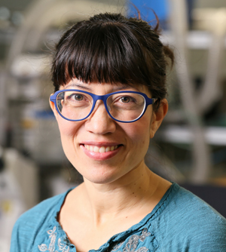
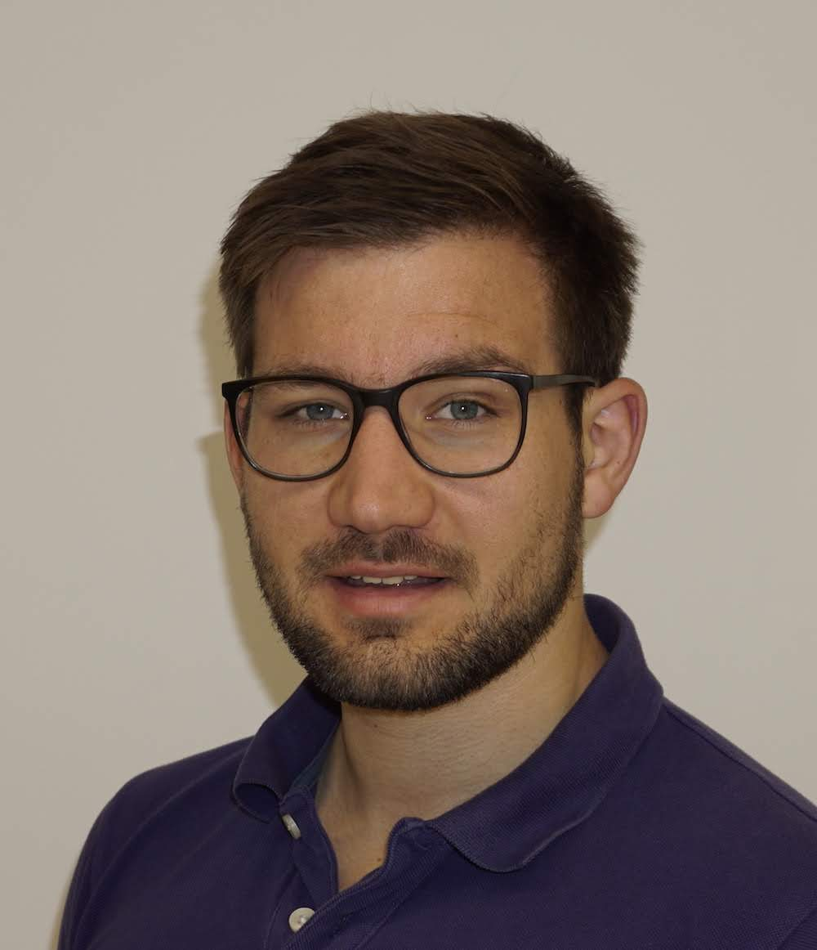
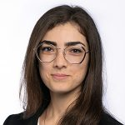
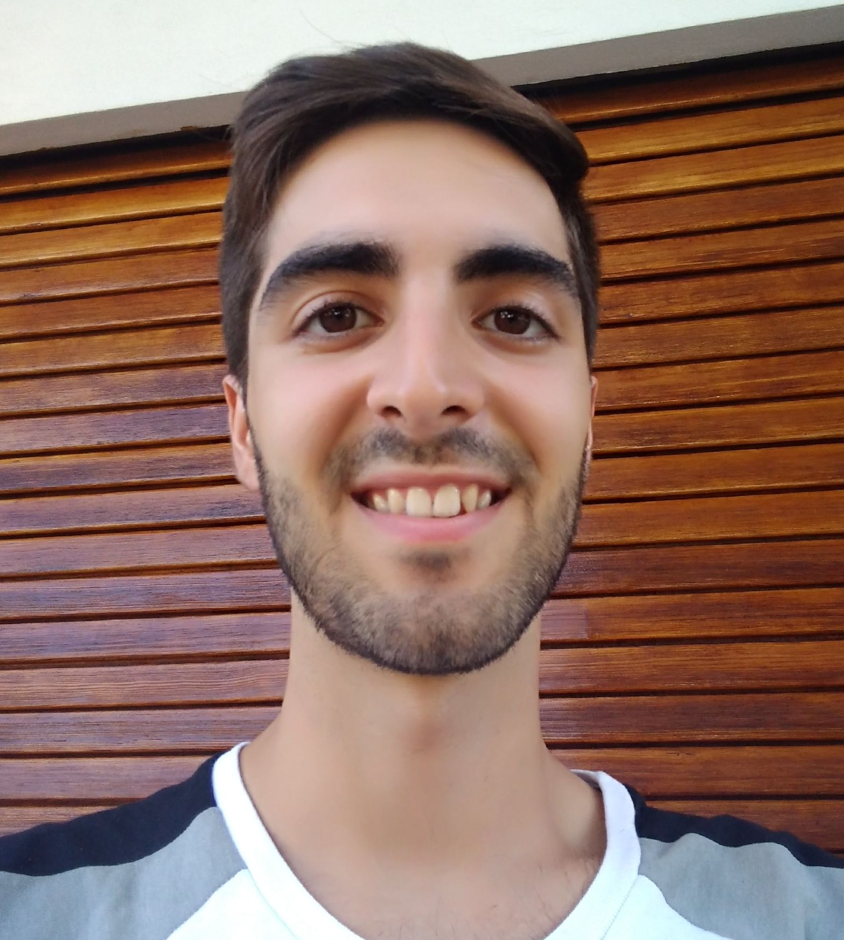

Suliana
Manley
(Lab head)
Willi
Stepp
(Postdoc)
Sheda
Ben Nejma
(PhD)
Santiago
Rodriguez
(SRP)
github.com/LEB-EPFL/MitoSplit-Net
Notes:
GitHub link
In the GitHub link you can see on the lower left corner, you can find more information about MitoSplit-Net and track the advances.
Acknoledgements
Finally, let me thank the EPFL for incredible opportunity and, especially, the team that makes this possible: my advisor Suliana Manley, who is the lab head, and also my supervisors Willi Stepp and Sheda Ben Nejma, posdoctoral and doctoral students from the lab.

